Slide 1
BIFX 503: Statistics for Bioinformatics
Instructor: Jennifer Schroeder, Ph.D.
Wednesdays, 5:30-8:00pm
Hodson Technology Center, Room 237
Fall 2021

Slide 2
Content
Generalized Linear Models
Logistic regression

Slide 3
Generalized Linear Models

Slide 4
What are Generalized Linear Models?
Generalization of linear regression techniques
Encompasses more than normally distributed dependent variables
Method extended to include binary and count data, among others
The dependent variable is predicted by a linear set of independent variables
The dependent variable is joined to the linear predictors by a link function

Slide 5
Components of Generalized Linear Models
Dependent variable (Y)
Distribution from the exponential family
Linear predictor (X’s)
independent variables
Link function
Relates the expected value of Y to the linear predictor

Slide 6
Techniques in the GLM
Simple Multivariate Form:
Multiple linear regression
ANOVA
ANCOVA
Logistic regression
Poisson regression
Survival analysis
Repeated measures
Full Multivariate Form:
MANOVA
MANCOVA
Factor analysis & PCA
Profile analysis
Discriminant function analysis
Bivariate Form:
Correlation
Simple linear regression
Text: Barbara Tabachnick & Linda Fidell’s Using Multivariate Statistics, 4th ed. Allyn & Bacon, 2001.

Slide 7
Forms of Regression
Type | Outcome Variable | Link Function | Measure of Association
Linear | Continuous | Identity | Change in Y per unit increase in X
Logistic | Binary | Logit | Relative odds of Y per unit increase in X
Poisson | Count | Log | Relative risk of Y per unit increase in X

Slide 8
Key Assumptions
Observations are independent and identically distributed (iid)
Data are cross-sectional, not longitudinal!
Methods have been developed to extend to correlated outcomes (GEE, GLMM)
Linear relationship between DV and IVs
Homoscedasticity (homogeneity of variance)
Standard deviations of the error term are constant and not dependent on the IVs

Slide 9
Independent Variables
IVs can be either continuous or discrete
Continuous IVs do not need to be normally distributed
Discrete IVs should be coded so that there is a reference category that the other levels are compared to
E.g. Drug=0 (placebo), =1 (tx1), =2 (tx2)
IVs can be correlated but not too highly

Slide 10
Model Fitting
Same procedure as for linear regression
Balance goodness-of-fit with complexity
Iterative in nature
Goal is an explanatory model with good fit to data
Examine model fit statistics at each step

Slide 11
Inference
Same as for linear regression
Parameter estimates (slopes)
Hypothesis tests: slope = zero?
Confidence intervals
Overall model fit
Different methods for assessing fit
Information Criterion, e.g., AIC, BIC

Slide 12
Logistic Regression

Slide 13
Logistic Regression
Answers the same questions as linear regression, only the outcome is binary instead of continuous
E.g. low birth weight yes or no
Instead of wanting to know the change in Y associated with X, you want to know the probability of Y associated with X
For example:
Is maternal smoking associated with the probability of low birth weight?

Slide 14
Logistic Regression
The logit function
logit(Y)=ln(Y/(1-Y))
Constrains the outcome probability 0<p<1
Allows the regression coefficients to have an odds ratio interpretation
e^{β1} = odds ratio for Y associated with a unit increase in X₁

Slide 15
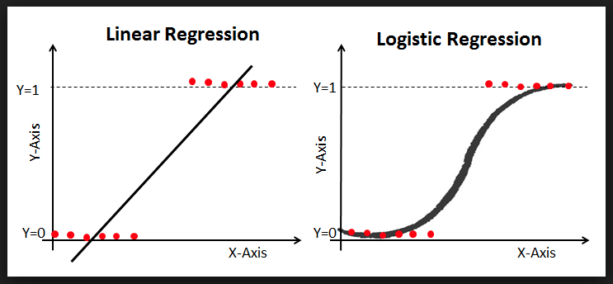

Slide 16
Risk vs. Odds
Risk
Simply a probability or relative frequency
Odds
Ratio of two probabilities: the probability of an event happening divided by the probability of it not happening
Odds of heads from one toss of a fair coin = 0.5/0.5 = 1
Odds of two heads in two tosses = 0.25/0.75 = 1/3
Odds ratio
Ratio of two odds

Slide 17
Interpretation of Logistic Regression Coefficients
e^{β1} = odds ratio (OR) for Y associated with a unit increase in X₁
OR=2.0 means that a unit increase in X1 makes the outcome twice as likely
Positive association, positive sign on β₁
OR=0.5 means that a unit increase in X1 makes the outcome half as likely
Negative association, negative sign on β₁

Slide 18
Inference
Overall model
Overall goodness-of-fit tests (χ², Hosmer-Lemeshow)
Pseudo-R²
Contribution of individual IVs
Wald test to determine if coefficient≠0
Confidence limits on the coefficient (does it include 0, i.e. does the OR include 1)
If adding several IVs at once, a χ² or likelihood ratio test can determine if adding them adds predictive ability to the model

Slide 19
Logistic Regression in R
glm(y ~ x, data, family=binomial(logit))
y = binary dependent variable (0/1)
x = independent variable
Can be continuous or categorical
family=binomial(logit)
Identifies link function

Slide 20
Logistic Regression in R
fit <- glm(y ~ x, data, family=binomial(logit))
Fits logistic regression model
Stores results as variable “fit”
summary(fit)
Prints summary
exp(coef(fit))
Prints exponentiated coefficients
exp(confint(fit))
Prints exponentiated confidence bounds

Slide 21
Logistic Regression Example
Blood screening data plasma from HSAUR3 package
Utility of erythrocyte sedimentation rate (ESR) in screening for disease
ESR<20 is “healthy”
Is ESR>20 associated with levels of plasma proteins fibrinogen and globulin?
If not, then these measures are not likely to be useful in screening for disease

Slide 22
Blood Screening Example
Both proteins slightly higher for ESR > 20
Lots of similarity (overlap)

Slide 23
Blood Screening Example
Run 2 logistic regression models to see if each plasma protein is associated with ESR>20
Without considering the effect of the other protein
Run a model having both plasma proteins as independent variables
Do the associations change?
Use anova() to see if including both proteins improves model fit
Note: use option test=“Chisq” for logistic regression

Slide 24
Blood Screening Example
Model | Regression Coefficient(s) ± SE (p value) | OR with 95% Confidence Interval(s)
ESR ~ fibrinogen | 1.83 ± 0.90 (0.043) | 6.22 (1.40, 54.5)
ESR ~ globulin | 0.14 ± 0.10 (0.17) | 1.15 (0.94, 1.43)
ESR ~ fibrinogen + globulin | 1.91 ± 0.97 (0.049) 0.16 ± 0.12 (0.19) | 6.76 (1.40, 73.0) 1.17 (0.94, 1.53)
Addition of globulin to the model did not substantially improve model fit (p=0.17)
Final model: fibrinogen alone predicting ESR

Slide 25
Blood Screening Example
Fibrinogen is associated with ESR > 20 while globulin is not
Association is statistically significant (p<0.05)
OR > 1, confidence interval excludes 1
Adding globulin to the model does not improve fit
How do these proteins do at classifying patients as ESR > 20?

Slide 26
Medical Screening Tests
Sensitivity: Proportion of people who test positive among those that have the condition
Specificity: Proportion of people who test negative among those that do not have the condition
Positive Predictive Value (PPV): Probability that an individual has the condition, if they tested positive
Negative Predictive Value (NPV): Probability that an individual does not have the condition, if they tested negative
Sensitivity and Specificity are characteristics of the test, and are independent of the prevalence of the disease, whereas PPV and NPV do depend on prevalence

Slide 27
Confusion Matrix
Truth
 | Yes | No
Yes | True Positives (TP) | False Positives (FP)
No | False Negatives (FN) | True Negatives (TN)
Classification
Sensitivity = TP/(TP+FN)
Specificity = TN/(TN+FP)
PPV = TP/(TP+FP)
NPV = TN/(TN+FN)

Slide 28
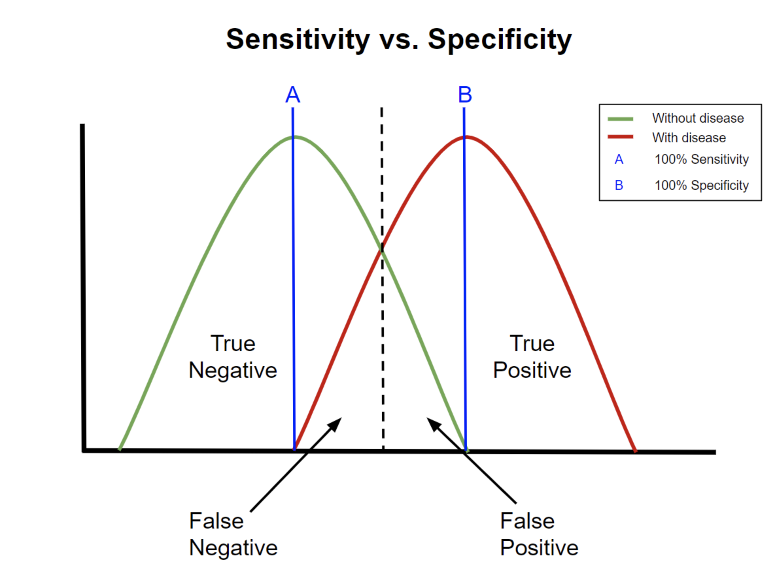
Image credit: https://commons.wikimedia.org/w/index.php?curid=97286749

Slide 29
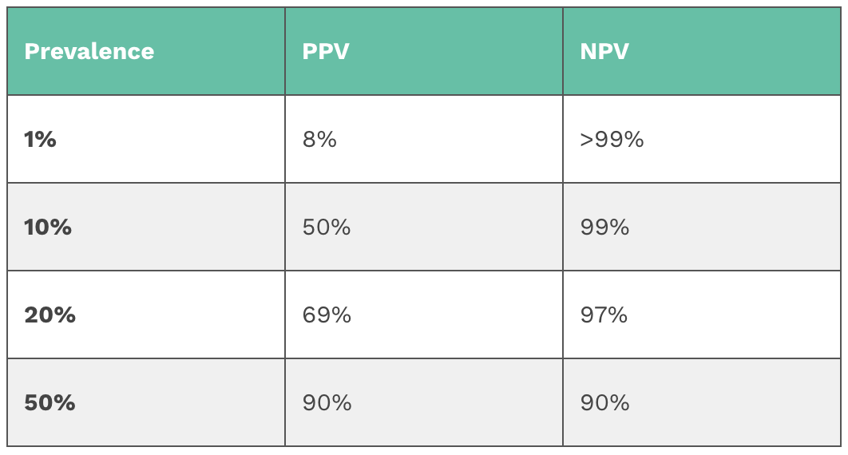
Impact of Disease Prevalence
As prevalence decreases (the disease becomes more rare), the PPV will go down and NPV will go up because there will be more FP for every TP, i.e. you are looking for a “needle in a haystack”
Image credit: https://geekymedics.com/sensitivity-specificity-ppv-and-npv/

Slide 30
ROC Curves
A receiver operating characteristic (ROC) curve is a graphic that illustrates the diagnostic ability of a binary classifier
The area under the curve (AUC) is a measure of how well the classifier performs
Over 0.90 is Excellent
0.80-0.90 is Good
0.70-0.80 is Fair
Illustrates the tradeoff between sensitivity and specificity
Tests with higher sensitivities tend to have lower specificities and vice versa

Slide 31
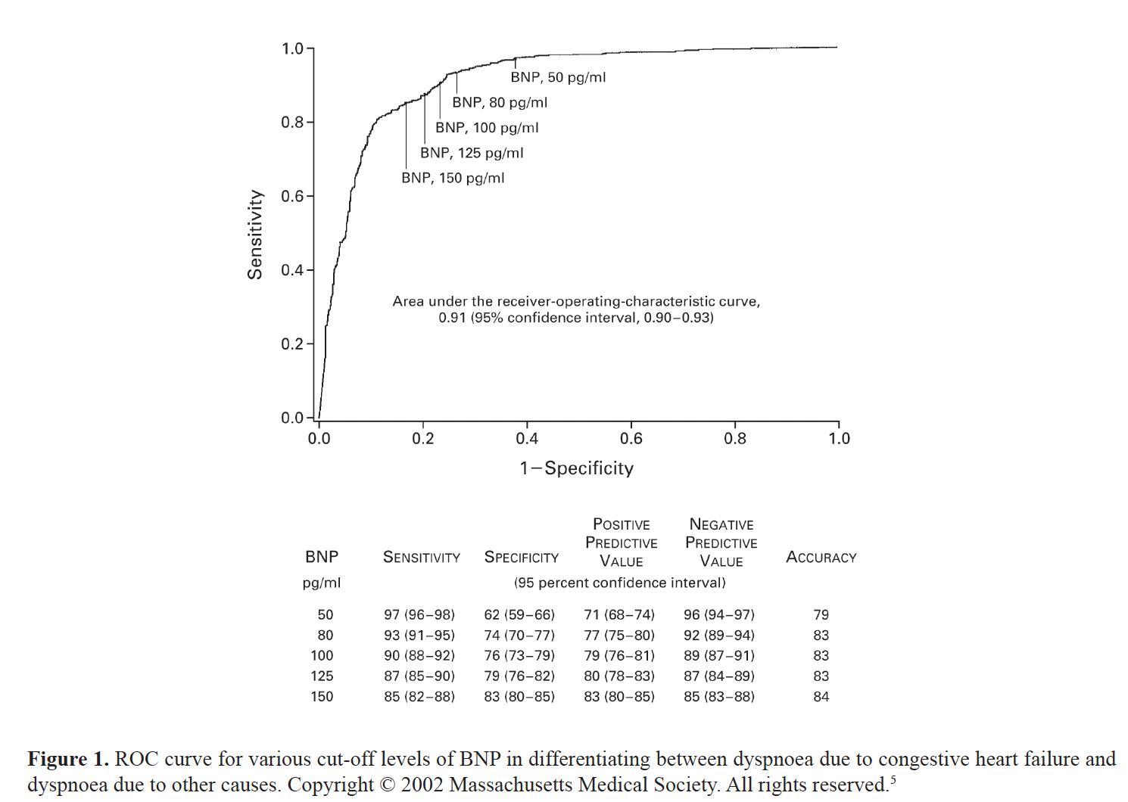
Sensitivity - Specificity Tradeoff
From Florkowski Clin Biochem Rev 29 Suppl(i) August 2008

Slide 32
Generating ROC Curves in R
library pROC
function roc()
fit <- glm(y ~ x, data, family=binomial(logit))
pred <- predict(fit, type=“response”)
roccurve <- roc(data$y ~ pred)
plot(roccurve)

Slide 33
Blood Screening Example
Fibrinogen
Fibrinogen + Globulin
AUC = 0.71
AUC = 0.81

Slide 34
Blood Screening Example
Model with fibrinogen alone
ROC AUC = 0.71
Fair
Model with both proteins
ROC AUC = 0.81
Good
Addition of globulin did not meaningfully impact model fit, yet it does improve the model’s performance as a classifier
Which is the better model? Depends on your objective
Explanation vs. prediction
More on predictive models next week …

